Slide 1


Lecture No:22
Topic: Sequence Impedance and Networks of Synchronous Machine
Course: Power System Analysis
Presented by
Dr M.S.Giridhar
Professor, Department of EEE
Lakireddy Bali Reddy College of Engineering (Autonomous)
Developed by
Jawaharlal Nehru Technological University Kakinada
www.jntuk.edu.in

Slide 2
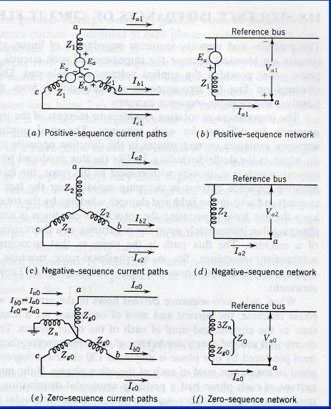
Symmetrical Networks of generator

Slide 3
Sequence Impedance and Networks of Synchronous Machine
When the machine carries positive sequence currents, (balanced mode of operation) the armature reaction field causes the positive sequence currents rotates at synchronous speed in the same direction as the rotor.
The Machine equivalently offers a direct axis reactance whose value reduces from X’’_{d} and transient reactance of X’_{d} when the short circuit current progresses in time.
Z₁ = jX’’_{d} (if 1 cycle (20ms) transient is of interest)
Z₁ = jX’_{d} (if 3-4 cycle (20ms) transient is of interest)
Z₁ = jX_{d} (if steady state value is of interest)
V_{a1} = E_{a} – Z₁I_{a1}

Slide 4
Negative sequence Impedance and network
With the flow of negative sequence currents in the stator a rotating field is created which rotates in the opposite direction to that of positive sequence field, and at double the synchronous speed w.r.t rotor.
Currents at double the stator frequency are induced in the rotor field and damper windings.
Z₂ = j(X’’_{q}+X’’_{d}/2) ; |Z₂| < |Z₁|
V_{a2} = - Z₂I_{a2}

Slide 5
Zero Sequence Impedance and network
The flow of zero sequence currents creates three m.m.f’s which are in time phase by 120⁰
The resultant air gap field caused by the zero sequence currents are zero.
Zero sequence currents flow in Rotor windings represent leakage reactance.
Z₀ < Z₁ < Z₂
V_{a0} = -3Z₀I_{a0} – Z_{og}I_{a0} = - Z₀I_{n}– Z_{og}I_{a0}
Where I_{n} = 3I_{a0}

Slide 6
Values of Sequence Impedance of Syn.Generator
Typical values of sequence impedances of a Turbo generator rates 5 MVA, 6.6 kV, 3000 rpm.
Z₁ = 12% (Sub-transient)
Z₁ = 20% (Transient)
Z₁ = 110% (Synchronous)
Z₂ = 12%
Z₀ = 5%

